Slide 1


JOY OF ENGINEERING
Project: AI Voice Assistant Using Raspberry Pi-4
Team Members: Aditya Choudhary(CSE-4)
Ayush Kumar(CSE-4)
Lakshay Yadav(CSE-1)
Kesariravi Venkata Simha Reddy(CSE-1)
Yugraj Saini(CSE-4)

Slide 2

INTRODUCTION OF THE PROJECT
Voice Assistant started back in 2011 with Apple Siri. Since then, many updates and improvements have been done and many new technologies have invented for people to effectively use the voice assistant.
Our group will try to simulate the same concept using Raspberry Pi-4 and Re-Speaker 2 Mic Pi-Hat.
We will make a voice assistant with voice and speech recognition. The objective of speech and voice recognition is to recognize WHO is speaking and comprehend WHAT is being spoken.
The voice assistant would be able to answer a variety of questions including messaging, date and time, showing weather report etc.

Slide 3
DELIVERABLES AND TIMELINE
FIRST OBJECTIVE | CODING SIMULATION ON PYCHARM
SECOND OBJECTIVE | HARDWARE ASSEMBLY
THIRD OBJECTIVE | HARDWARE DEMONSTRATION AND TRANSFERRING THE CODE IN RASPBERRY PI-4
FOURTH OBJECTIVE | FINAL PROTOTYPE TO BE DEMONSTRATED

Slide 4
DELIVERABLES AND TIMELINE
FIRST OBJECTIVE | CODING SIMULATION ON PYCHARM
SECOND OBJECTIVE | HARDWARE ASSEMBLY
THIRD OBJECTIVE | HARDWARE DEMONSTRATION AND TRANSFERRING THE CODE IN RASPBERRY PI-4
FOURTH OBJECTIVE | FINAL PROTOTYPE TO BE DEMONSTRATED

Slide 5
DELIVERABLES AND TIMELINE
FIRST OBJECTIVE | CODING SIMULATION ON PYCHARM
SECOND OBJECTIVE | HARDWARE ASSEMBLY
THIRD OBJECTIVE | HARDWARE DEMONSTRATION AND TRANSFERRING THE CODE IN RASPBERRY PI-4
FOURTH OBJECTIVE | FINAL PROTOTYPE TO BE DEMONSTRATED

Slide 6
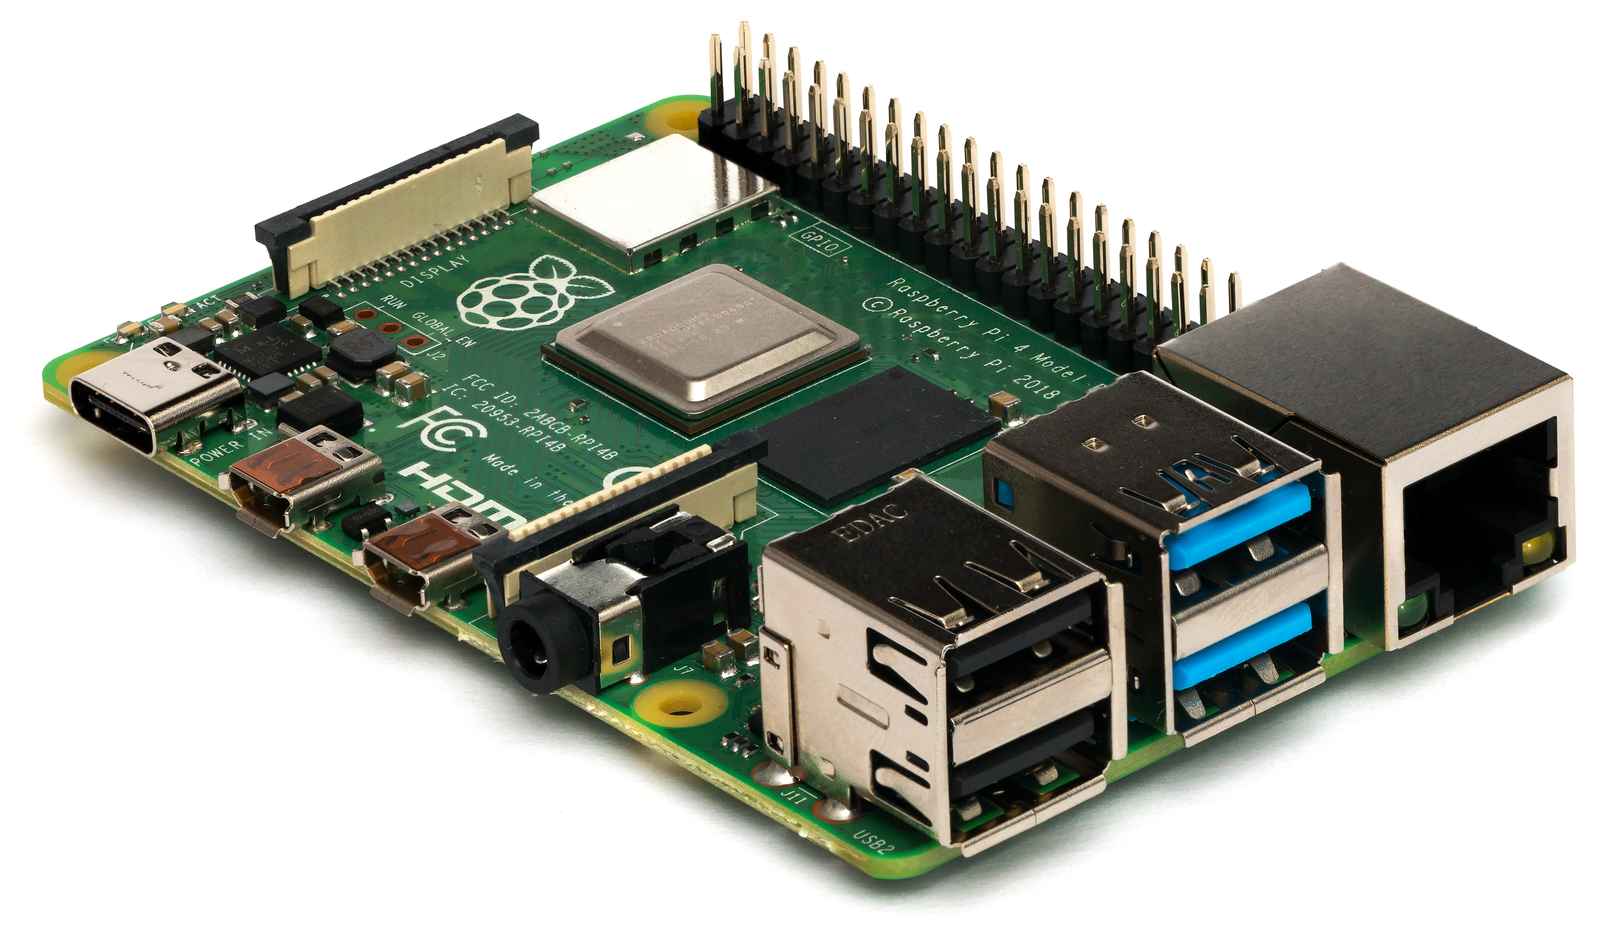
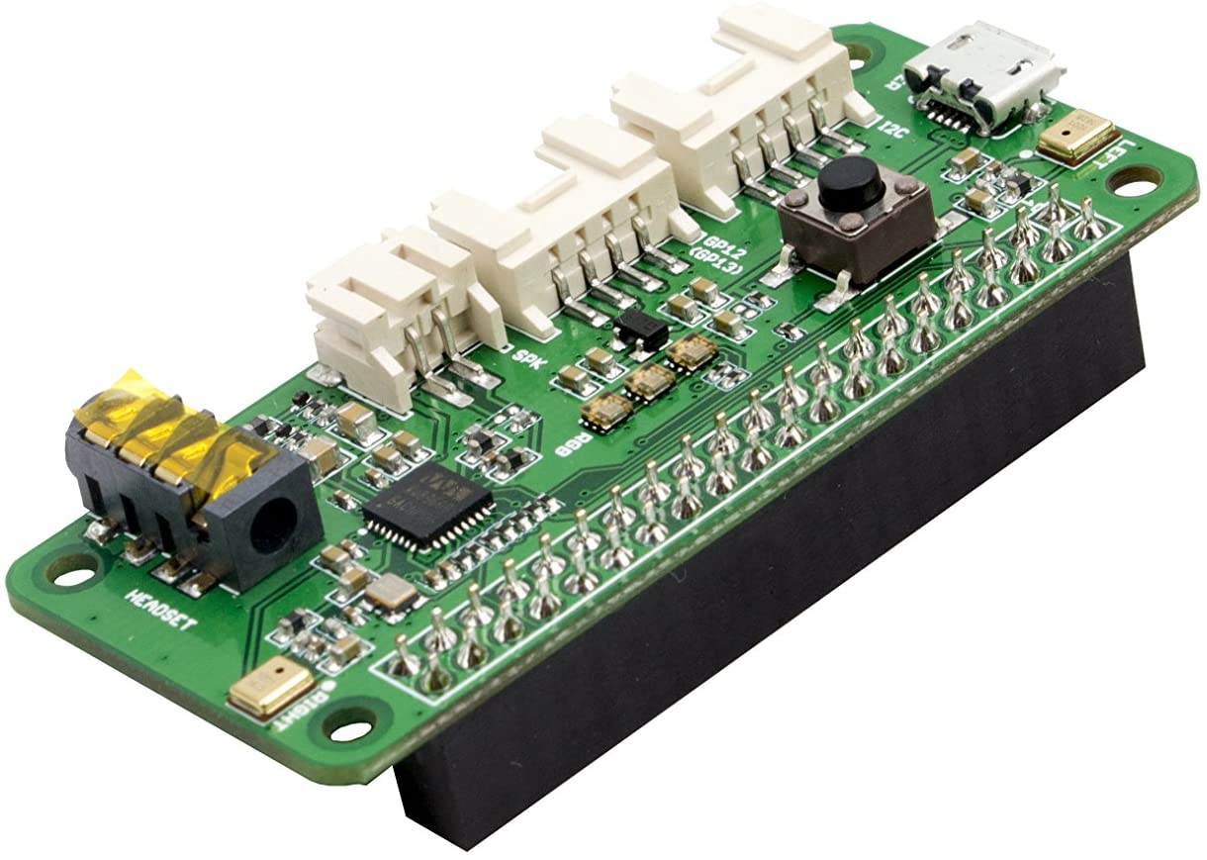
COMPONENTS OF THE ASSISTANT
Hardware components:
1.) Raspberry Pi-4 Model-B
2.) Re Speaker-2 Mic Pi-Hat
3.) Speakers
Software components:
1.)Py-Charm( For initial stages of the project)
2.)Thonny Python(In- Built in Raspberry Pi-4)
Raspberry Pi-4 Model-B
Re-Speaker 2 Mic Pi-Hat

Slide 7

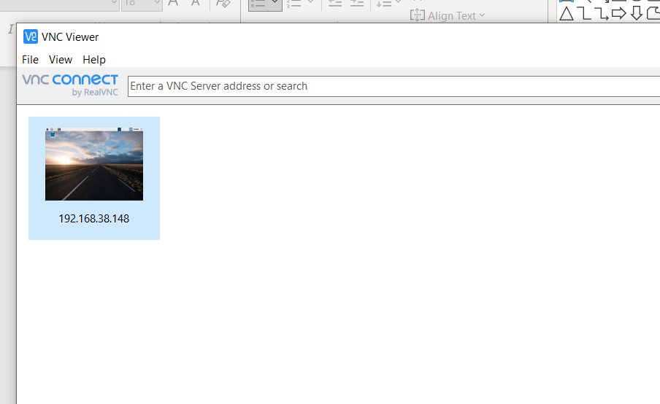
PROPOSED SOLUTION
Finding the IP Address of the Raspberry Pi-4 and by using Remote Desktop Configuration or VNC Viewer, the Pi- Screen is shared on the laptop screen. Here we are using VNC Viewer for faster response.

Slide 8
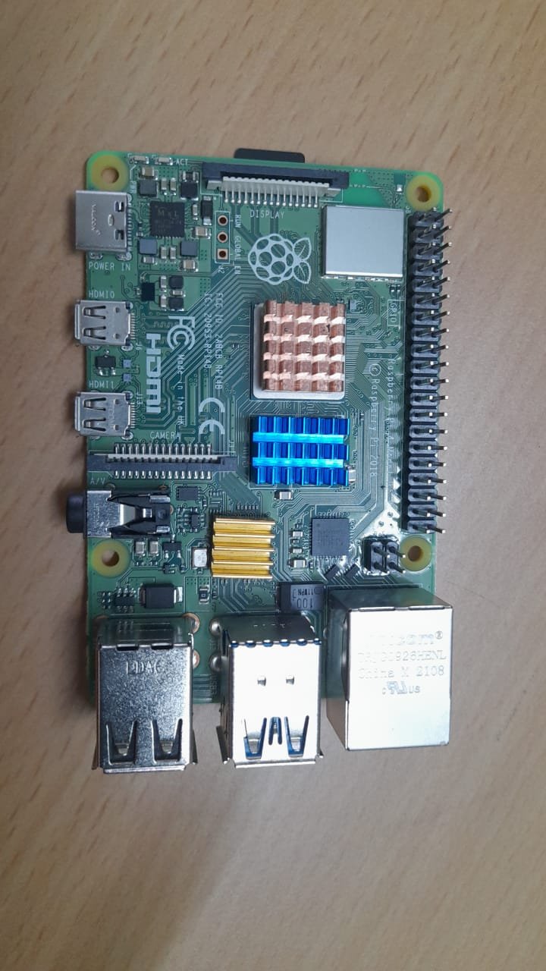
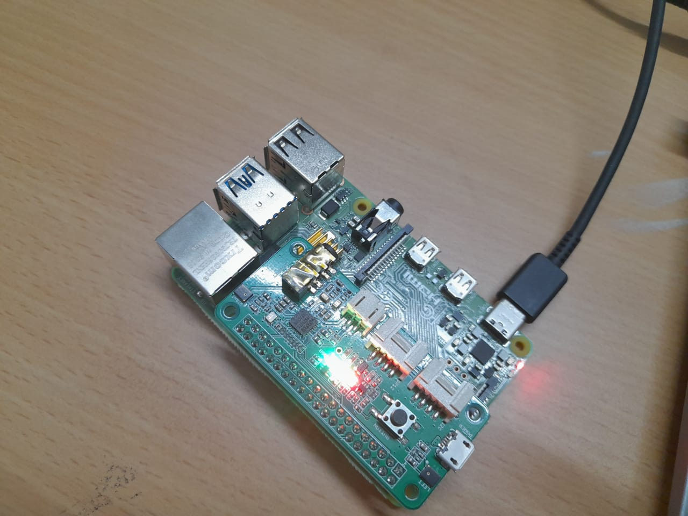
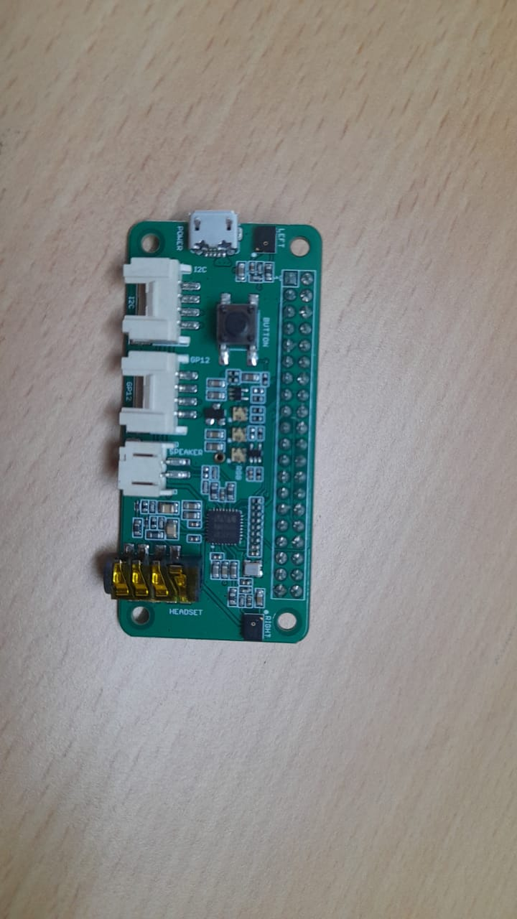
Setting up the Raspberry PI-4 Model B and Re-Speaker 2 Mic Pi-Hat. Power is given through the USB Type C Port in the Raspberry Pi-4.

Slide 9
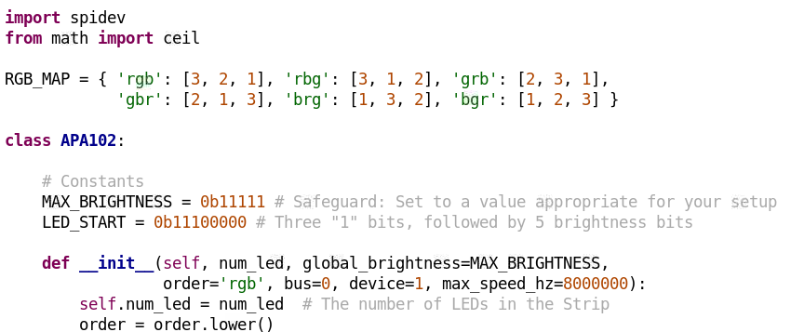
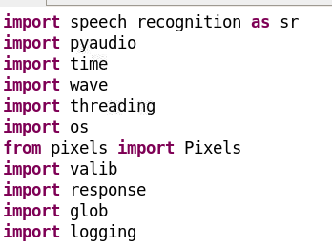
The code is written in Thonny Python and various files has been created to fulfil specific tasks. Below are the four main files:
main.py : All the libraries are imported in this file and contains the details of the Re-Speaker Index.
apa102.py: Related to the led’s on Re-Speaker.
response.py: Contains all the actions that the voice assistant can perform.
action.py: Contains the functions defined for the response.py.

Slide 10
CONTRIBUTION OF EACH MEMBER
1. Aditya Choudhary: Coding, Presentation, Project Report, PPT Slides Making and Explanation
2. Ayush Kumar: Demonstration, PPT Slides Making and Explanation, Coding, Project Report
3. Kesariravivenkata Reddy: Project Report, PPT Slides Explanation, Project Equipment's
4. Lakshay Yadav: Hardware Research and Project Equipment’s
5. Yugraj Saini: Project Report, PPT Slides Explanation, Project Equipment’s

Slide 11

THANK YOU

